Slide 1

Microsoft Movie Analysis

Slide 2
Contents
Summary
Business Problem
Datasets
Methodology
Movie type
Release month
Production budget
Studio type
Conclusion

Slide 3
Summary
I analyzed the highest-grossing movies and determined what makes them so successful. My analysis will help you make the best possible movie based on the following criteria: an adventure movie with the slight focus on crime released in June or December, with an appropriate budget and should take inspiration from BV and WB studios.

Slide 4
Business problem
Microsoft want to break into the multi-billion dollar movie industry, but they don’t know where to begin.
These factors should be looked before making a successful movie:
Movie Type
Release Month
Production Budget
Type of Studio

Slide 5
DATASETS
We used 3 different datasets having different features. Following are the datasets used:
Bom.movie_gross
Tn.movie_budgets
Tmdb.movies

Slide 6
Methodology
We utilized descriptive statistics as well as visualizations to illuminate trends in the data and isolate key factors for making a successful movie.

Slide 7
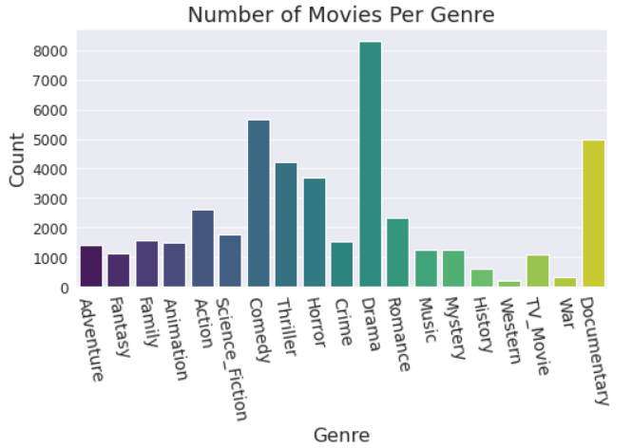
Movie Type

Slide 8
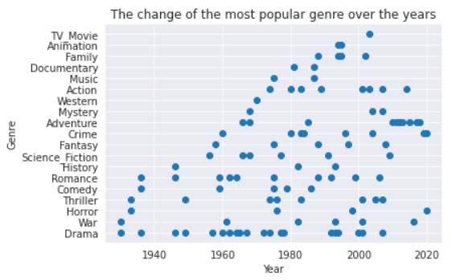
Movie Type

Slide 9
Movie Type
We can see that most number of movies have Drama as genre and Westren genre has the least number of movies. And over the years adventure movies are more in trend now.

Slide 10
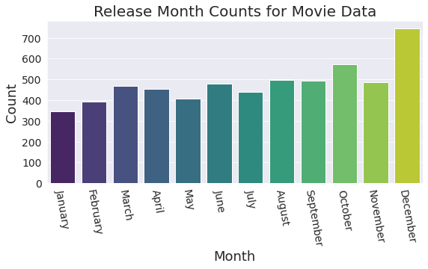
Release month
The most releases in December and the least in January.

Slide 11
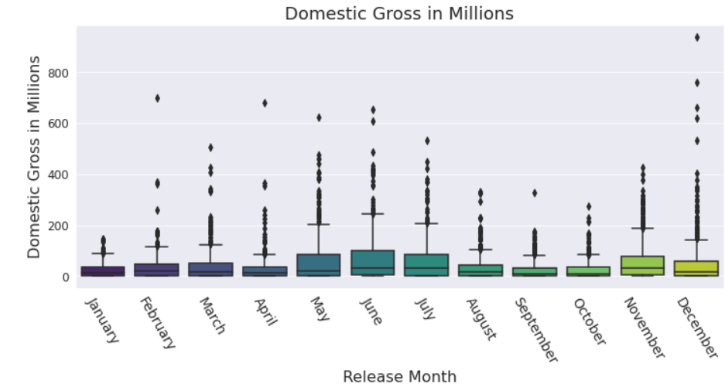
Release month
Domestic gross by Release month

Slide 12
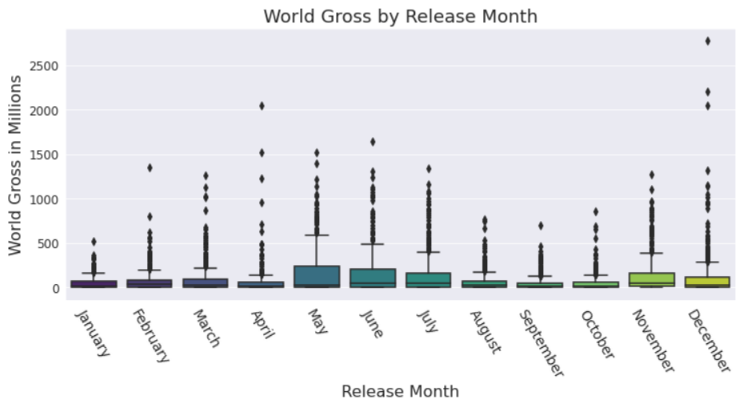
Release month
World gross by Release month

Slide 13
Release month
From release month visualizations we can see that movies released in December and June earned more than others.

Slide 14
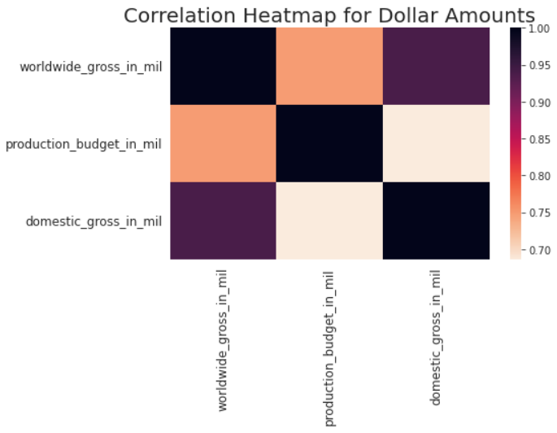
Production budget
Correlation of production budget with World and Domestic gross.

Slide 15
Production budget
The heat map shows darker colors where two values are highly correlated and lighter colors where there is less of a correlation. It was clear from the heat map that there was a strong correlation between budget and world gross, as well as budget and domestic gross. From this visualization, I could conclude that, generally speaking, the more money you put into a movie, the more money you are likely to make from it.

Slide 16
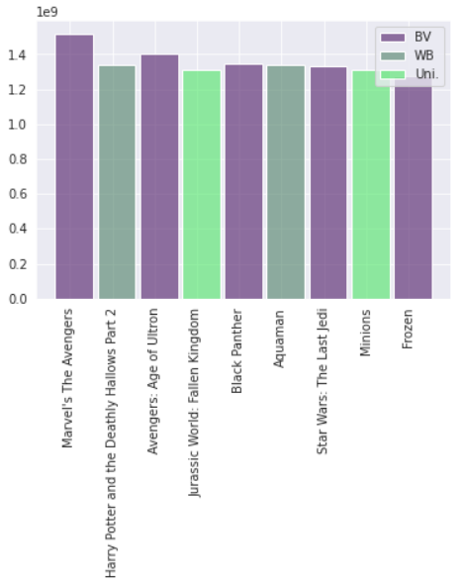
Studio Type
We can see that the top 10 highest earning movies are mostly from BV or WB studios. So we can take inspiration from them or follow their style to make movies.

Slide 17
Conclusion
I would recommend that Microsoft release the movie with these four specific recommendations that have proven to be successful combinations:
an adventure movie with the slight focus on crime
with a production budget of 150 to 200 million dollars
should be released in June or December
should take inspiration from BV or WB studios

